Slide 1
Development of an AI-System for Classification of Error Causes in Large Log Files within a CI Environment
Entwicklung eines KI-Systems zur Klassifizierung von Fehlerursachen in Umfangreichen Log Files einer CI-Umgebung
PE-303S / JC-31

Slide 2
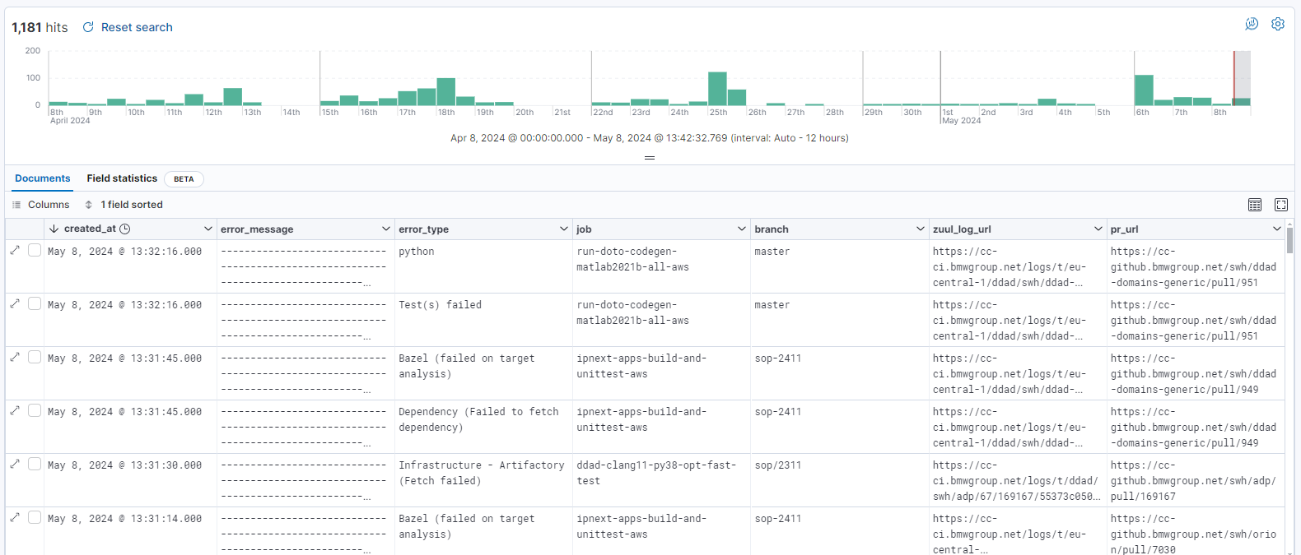
The Task
https://ddad-mon.bmwgroup.net/kibana/s/public-access/app/discover#/view/d2f9a140-27d0-11ee-a980-29183993e591?_g=(filters:!(),refreshInterval:(pause:!t,value:0),time:(from:now-30d%2Fd,to:now))&_a=(columns:!(error_message,error_type,job,branch,zuul_log_url,pr_url),filters:!(('$state':(store:appState),meta:(alias:!n,disabled:!f,index:c446adfd-1ebc-5b89-9ab9-97e390ed529b,key:pipeline.keyword,negate:!f,params:(query:gate),type:phrase),query:(match_phrase:(pipeline.keyword:gate))),('$state':(store:appState),meta:(alias:!n,disabled:!f,index:c446adfd-1ebc-5b89-9ab9-97e390ed529b,key:zuul_tenant,negate:!f,params:(query:ddad),type:phrase),query:(match_phrase:(zuul_tenant:ddad)))),grid:(),hideChart:!f,index:c446adfd-1ebc-5b89-9ab9-97e390ed529b,interval:auto,query:(language:kuery,query:''),sort:!(!(created_at,desc)))

Slide 3
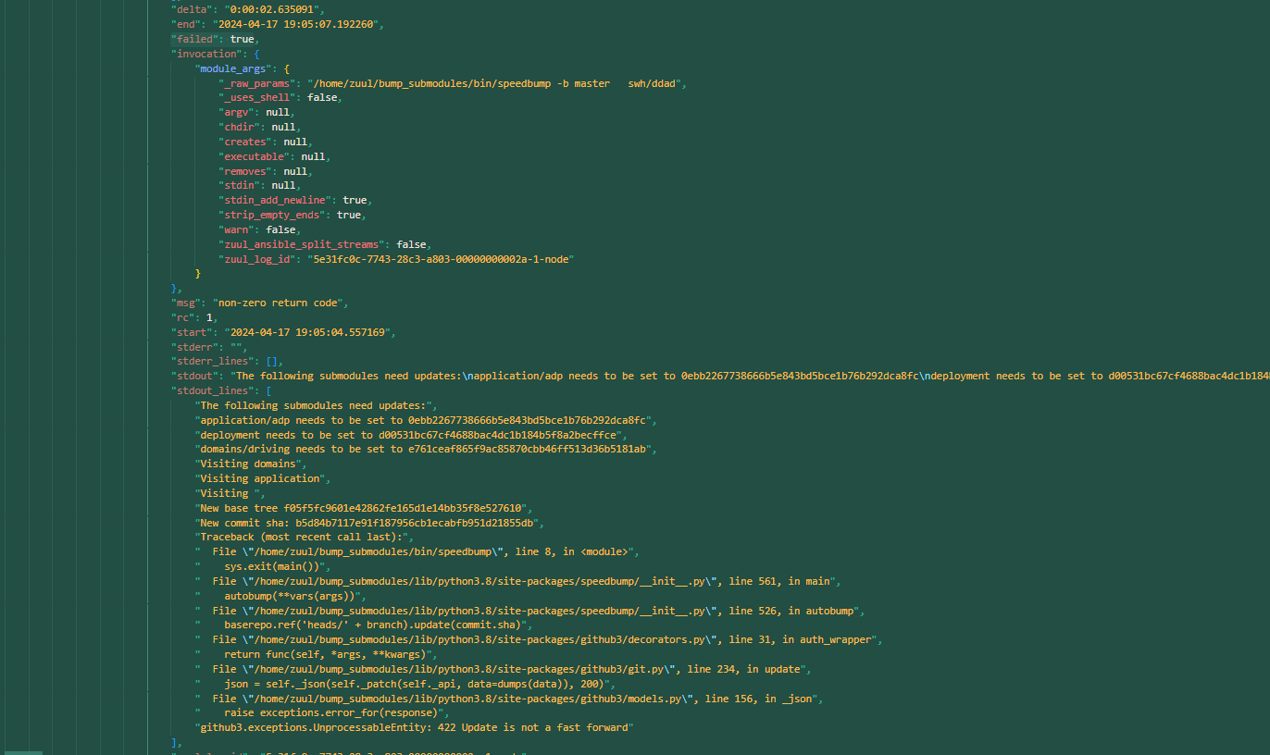
0062e5a17f0c5832bf20d4f810fd448701afd48426f87de5a448d6bc198abae2__job-output.json

Slide 4
Research
Main: Deep Learning with Python von François Chollet
Examples from book: https://github.com/fchollet/deep-learning-with-python-notebooks
Example Dataset: https://ai.stanford.edu/~amaas/data/sentiment/
Further Examples: https://keras.io/examples/nlp/text_classification_from_scratch/
Relevant Paper:
"Attention is all you need" by Vaswani et al.
K. Ghasedi, X. Wang, C. Deng and H. Huang, "Balanced Self-Paced Learning for Generative Adversarial Clustering Network," 2019 IEEE/CVF Conference on Computer Vision and Pattern Recognition (CVPR), Long Beach, CA, USA, 2019
→ For classification without having groundtruth!

Slide 5
Tentative Approach
- Data Preparation:
Extracting relevant information from log files
Standardization: Stemming
Tokenization of data
Encoding: One-Hot-Encoding, Embedding, etc.
- Modeling:
Utilizing Convolutional Neural Networks (CNN) / Deep Neural Networks (DNN) using TensorFlow/Keras
Comparison: Bag-of-Words approach vs. Sequential model

Slide 6
To be clarified:
- Log data access and processing:
How to access and work with the logs?
Preparation of logs: Cropping, labeling, etc.
filter by “failed": true then delete everything beside that ?
Network Architecture:
Which architecture is most suitable? Fnet, Unet, Alexnet?
Modeling Approach:
Stemming/standartizing
Bag-of-Words vs. Sequential Model
Depending on this: Tokenization Approach: N-gram, word-level
Use of Transformer models (for sequential model)?

Slide 7
Anmerkungen
- what is target performance metric?
- How to get groundtruth/label to logs?
- Warum keras? ->reasoning, mainly for final thesis!
-

Slide 8
Notes BA-Sync – 16.05.2024
Prepare pitch for professors and test with matthias markthaler (that dude can ask all the questions) & martin
Write the profs an email with hey, i got this idea for thesis with bmw, can i tell you more about it? --> then wait for anwer if they want in person or email :D
How to label data/logs with the regex ?
Connect known ones (~75%) by build id with elasticsearch information, label can be pulled from there
For unknown ones: tbd??
Convert to dictionary, then iterate tasks in there and search for std_error, throw away all tasks without that ?
Find task, take stderr & stdout_lines from that?
Error info is always in one of those
Filter for task instead of branch master thingy
Heuristics for multiple errors: which one is the most important causing the others?
Take first one?
some can fail but failed is also false there
But maybe information about areas that error occur in is relevant
Confidentiality levels for error types
figure out labeling & downloading?
Search for occurance
"task“:
"branch": "master", "index":
Before match + after match -1 line, then copy that area
"msg": "# Job Information\nAnsible Version: 2.15.10\nJob: foresight-sonarqube-bazel-scan\nPipeline: adp-check\nExecutor: zuul-executor-partition-0-10.zuul-executor-partition-0-eu-ash-15.ci.svc.cluster.local\nTriggered by: https://cc-github.bmwgroup.net/swh/foresight/pull/18922\nEvent ID: 802ef560-014f-11ef-99ce-0c88a858cea1\n"
could be useful to see where errors cluster/which repos/ etc
do specific pipelines/users/jobs/… often appear? Patterns there?
Filter for tasks with "name": Print job information for this ( maybe good to keep in cropped files?

Slide 9
Notes BA-Sync – 23.05.2024
Cancelled because of sickness
Notes BA-Sync – 30.05.2024
Holiday (Fronleichnam)

Slide 10
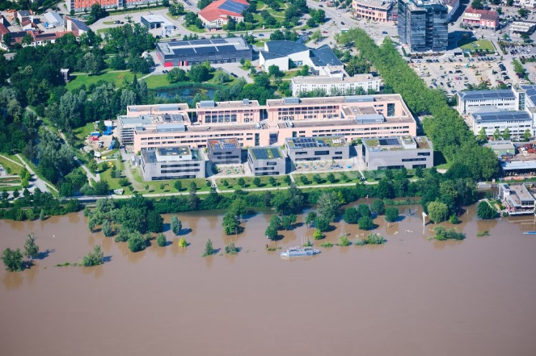
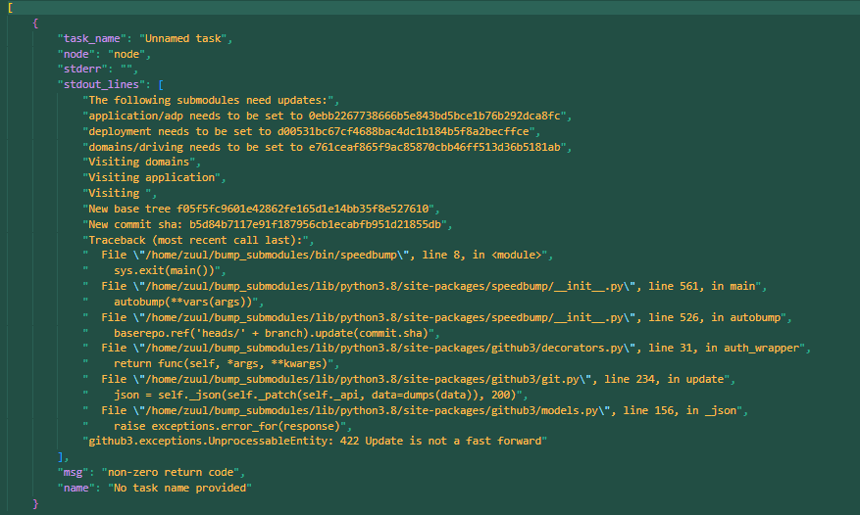
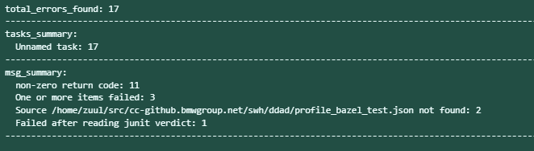
Notes BA-Sync – 06.06.2024
THD
https://cc-github.bmwgroup.net/carmenwerrlein/bachelor_thesis.git
Glauner hat abgelehnt, nach Empfehlungen gefragt (bzw. zwei weitere Dozenten kontaktiert)
→ noch keine Antwort
THD wegen Hochwasser aber akut bisschen im stress
Git repo
„Cropping“ der logs reimplementiert
Look for ‘failed‘: true, dann safe failed task in a dict ( including stderr, stdout, msg, name)
Multiple failed tasks in one log are kept in one cropped file
Summary function
Overview over processed logs
Amount of errors
Names of failed tasks as well as respective frequency
→ PROBLEM: ALL UNNAMED?, what is unique identificator for task?
Error essages of failed tasks as well as respective frequency
Open:
determine how to map error msgs to specific pipelines/users/jobs to look for
patterns?

Slide 11

Notes BA-Sync – 13.06.2024
https://cc-github.bmwgroup.net/carmenwerrlein/bachelor_thesis.git
PROGRESS:
LaTex template works (mostly)
Slides can be found in AI-Squad-Channel
Supervisor from University found ( Prof. Dr. Robert Hable)!
Refine Working title
Slides for Presentation
Sync/Intruduction with Sandra, Simon, Alex + Hable ( If needed)
OPEN TODOS:
- In job 005…., name & unique id is in line 32559 (after the task, include in extract function as well)
- create rough schedule until planned turned in date (backwards planning)
- figure out approach for generating training data
- around 200.000 playbook error out of 1.2 errors in total over the last year ( ~16%)
- maybe focus on getting error class first instead of specific error?
- get statistics for labeled errors (distribution, balanced vs. unbalanced, etc, everything else)
- Figure out strategy for labeling playbook errors(evtl. Ask for input in exchange session on Fridays?

Slide 12
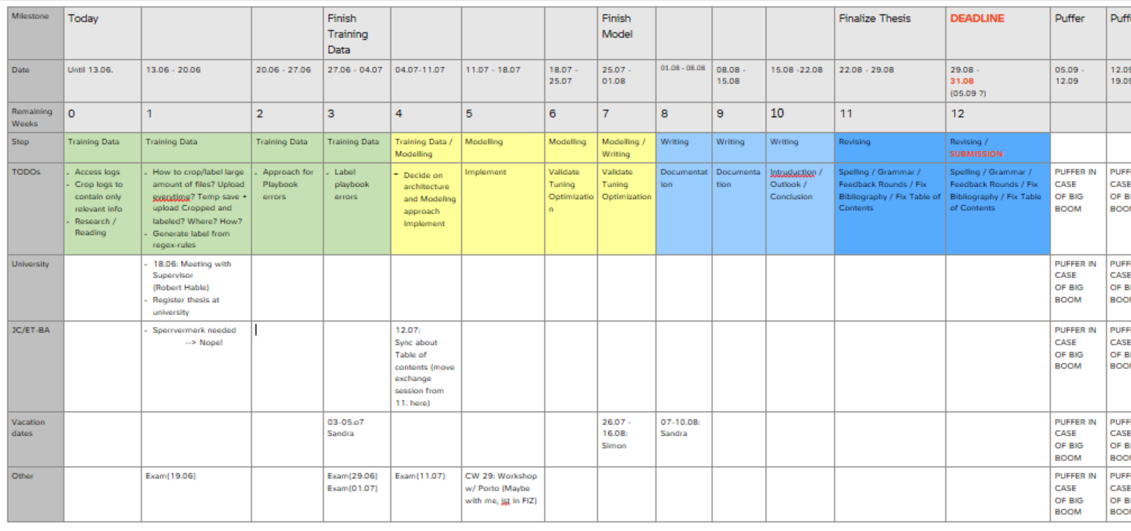
Notes BA-Sync – 13.06.2024
https://cc-github.bmwgroup.net/carmenwerrlein/bachelor_thesis.git
Draft: Timetable

Slide 13
Notes BA-Sync – 20.06.2024
https://cc-github.bmwgroup.net/carmenwerrlein/bachelor_thesis.git
PROGRESS:
-
OPEN TODOS:
- Use workstation for saving cropped and labeled data ? space
- download data using a filter to only get new logs
- download elastisearch labels
- Training model and label data – Workstation or some solution!
- Save every step of data preparation? (good for intermediate results, bad for storage)
- JC-Townhall Meeting? Talk about that with Sandra
- Presention/ Slot in Exchange Sessions

Slide 14
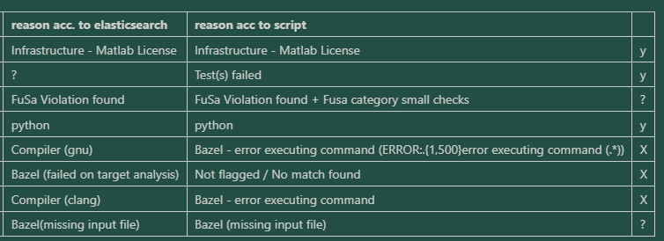
Notes BA-Sync – 27.06.2024 (1/4)
ISSUES:
18 logs in ‘test batch‘ with 34 errors
Reconsider keeping erros together?
Current Labeling status: Read and compile patterns, check all logs in dir for matches
→ Partially works, issues with ‘subtypes‘ ( details @ 4/4)
TODO: extract ID and save with label
How to map labels to error type (numerical, categorical, …?)
https://cc-github.bmwgroup.net/carmenwerrlein/bachelor_thesis.git
PROGRESS:
Training on B-Ilda 4 (JC-31 Builder with RTX A4000) should work . Needs specific Pytorch version: torch==2.0.1. (Thanks to Martin for checking!)
Some issues with RegEx matching for Labeling
OPEN TOPICS:
download data using a filter to only get new logs ? (later)
download Elasticsearch labels ? (later)
Storing Training Data !
JC-Townhall Meeting – Presentation at some point
Presentation in Exchange Sessions at some point

Slide 15
Notes BA-Sync – 27.06.2024 (2/4)
Main Ressources as of now:
- SecureBERT: https://arxiv.org/abs/2204.02685
- Deduplicating Data: http://arxiv.org/abs/2107.06499
- Confident Learning: http://arxiv.org/abs/1911.00068
- BERT: http://arxiv.org/abs/2204.02685
Attention is all: http://arxiv.org/abs/1706.03762
What happened until now:
Onboarding
Research, Paper reading prepwork
Logs to aws ( Sascha)
Script to crop logs
Search for: „failed“: true
Find interesting keys before that ( id, stdout, stderr)
Dump into new file with filename + cropped
Manually downloaded test batch ( ~15 files)
Occured Issues: pretty slow
Script to label known errors in cropped files according to RegEx-pattern
Figure out structure of regex
Some pattern are dicts with subtypes, only dict lists etc. – Problems making code to work with all of those
figure out for INFRA_PATTERN
Figure out for BUILD_PATTERN
Combine
Some subtypes are working now, others aren‘t -> Issue, that took almost a whole day to figure out
Do more things (decide on labels)
Decide for unlabeled, lots of different approaches rn, figure out and compare against
BERT ( but what kind? Pre trained models? Which one? Train my own?)
SecureBERT could be useful for log-file use case

Slide 16
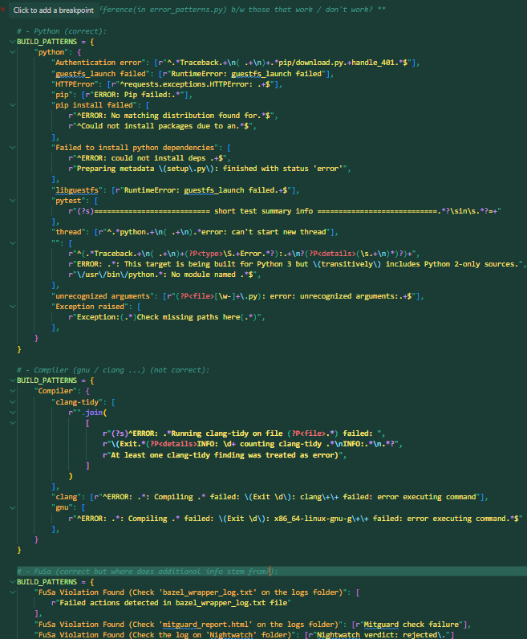
Notes BA-Sync – 27.06.2024 (3/4)
Example cases →

Slide 17
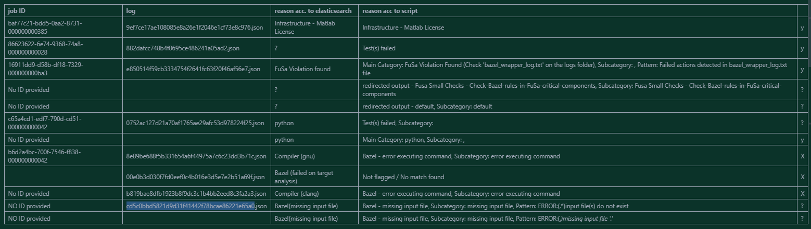
Notes BA-Sync – 27.06.2024 (4/4)
Overview

Slide 18
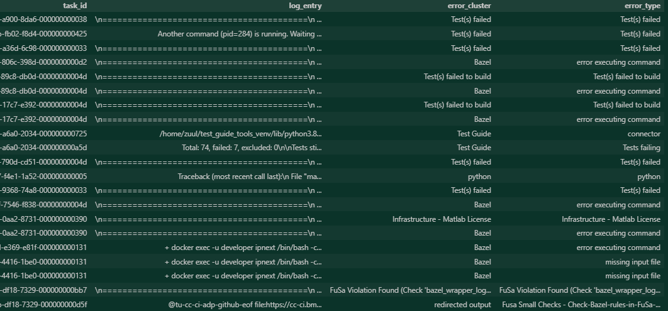
Notes BA-Sync – 25.07.2024
https://cc-github.bmwgroup.net/carmenwerrlein/bachelor_thesis.git
PROGRESS:
There are labels! Figured out RegEx matching (some exceptions tbd)
Model: RoBERTa, a pre-trained, BERT based model
Custom Tokenizer solution in Progress
Script for downloading object from AWS bucket (thank you Alex ☺)
OPEN Questions:
Label „playbook errors“ manually? Label at all? Semi-supervised? Reinforcement Approach?
Model: Classify with confidence? Without?
Performance optimization for preprocessing and labeling script
Improve downloading script (List, download multiple)
Get to know B-Ilda 4 (JC-31 Builder with RTX A4000) & start downloading

Slide 19
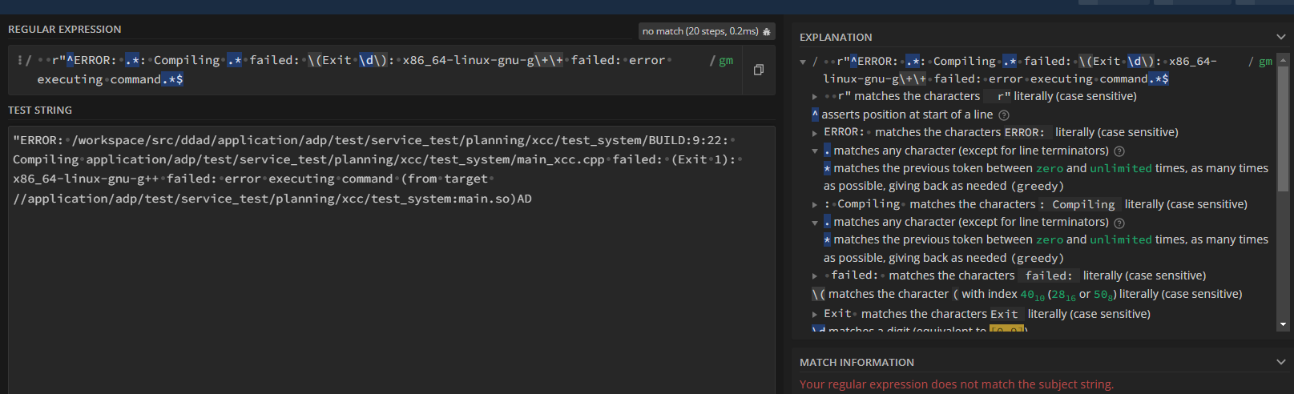
Notes BA-Sync – 25.07.2024
https://cc-github.bmwgroup.net/carmenwerrlein/bachelor_thesis.git
„Gnu“ Pattern from error_patterns.py
Relevant line from log that was classified as “Compiler Error (gnu)” in elasticsearch
Why does this not match?

Slide 20
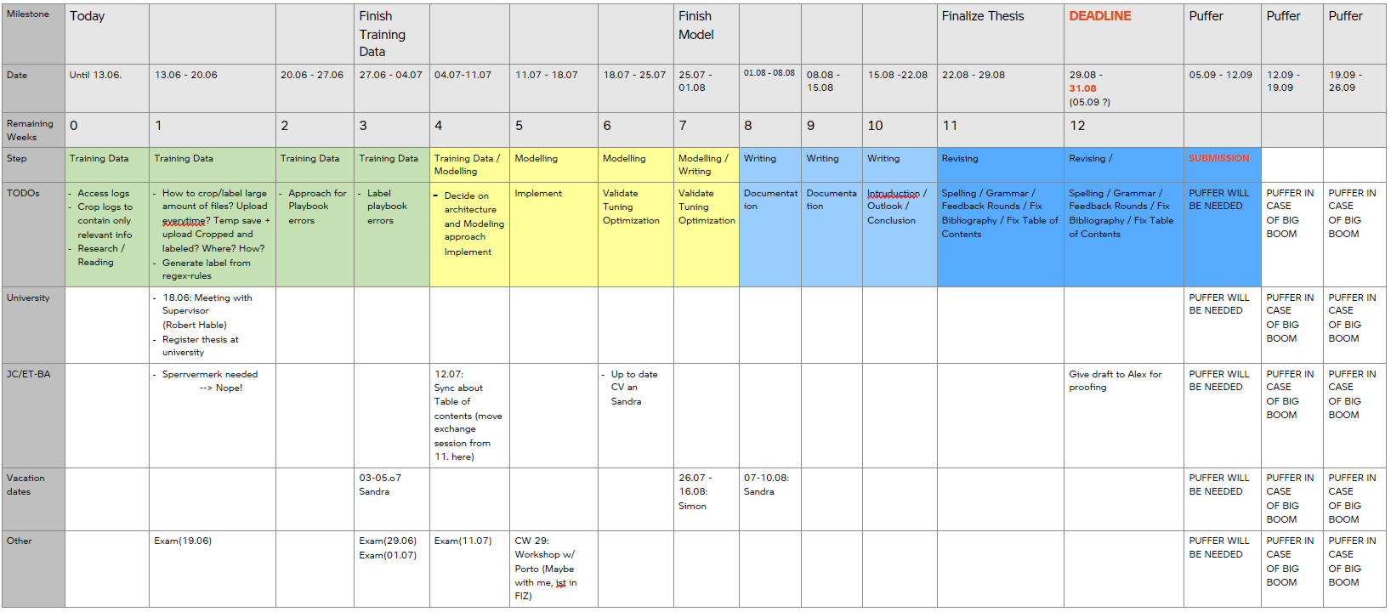
Notes BA-Sync – 25.07.2024
https://cc-github.bmwgroup.net/carmenwerrlein/bachelor_thesis.git
Updated milestone plan

Slide 21
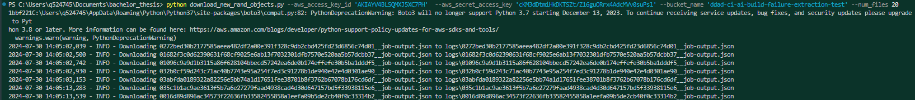

Notes BA-Sync – 01.08.2024
https://cc-github.bmwgroup.net/carmenwerrlein/bachelor_thesis.git
PROGRESS:
Functional Workflow:
Downloading x random, new logs from aws bucket (download_rand_new_objects.py)
Crop logs to relevant parts (crop_logs.ipynb) & safe in preprocessed_logs
Add label to preprocessed logs (data_labeling.ipynb)
Extended built-in tokenizer with domain specific vocabulary from preprocessed logs
Next Steps: Use custom tokenizer to create a baseline-model, then fine tune!
OPEN :
Label „playbook errors“ manually? Label at all? Semi-supervised? Reinforcement Approach?
Model: Classify with confidence? Without?
Performance optimization for preprocessing and labeling script
Improve downloading script (List, download multiple)
Get to know B-Ilda 4 (JC-31 Builder with RTX A4000) & start downloading

Slide 22
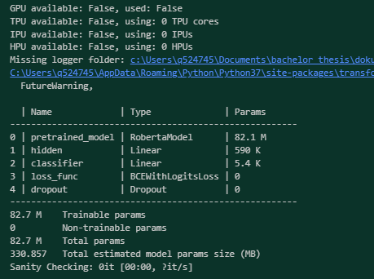
Notes BA-Sync – 09.08.2024
https://cc-github.bmwgroup.net/carmenwerrlein/bachelor_thesis.git
PROGRESS:
Created a working Model ( TODO: switch to custom Tokenizer)
OPEN :
Label „playbook errors“ manually? Label at all? Semi-supervised? Reinforcement Approach?
Model: Classify with confidence? Without?
Performance optimization for preprocessing and labeling script
Improve downloading script (List, download multiple)
Get to know B-Ilda 4 (JC-31 Builder with RTX A4000) & start downloading

